Slide 1

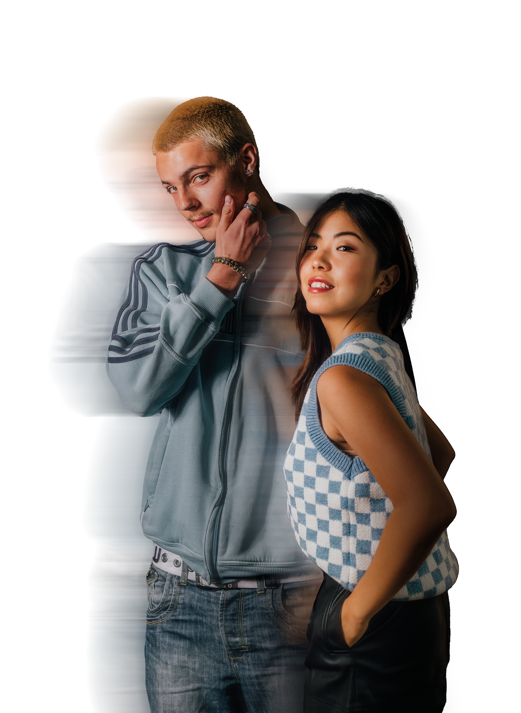
VISUAL MERCHANDISING
HOME OF FASHIONS NEXT GENERATION

Slide 2
WHAT IS VISUAL MERCHANDISING?
Influence consumers’ buying decisions using stories and displays and layouts, both instore and online​
​
Have an understanding of customers’ style aspirations and spending habits​
​
Think when you last went into a retail store, where did you encounter Visual Merchandising?​

Slide 3
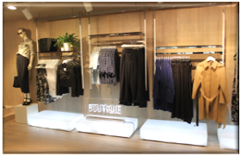
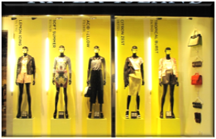
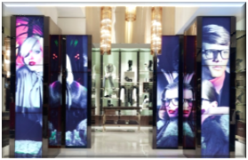
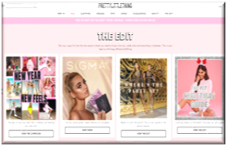
4 PILLARS OF VISUAL MERCHANDISING
Interior
Displays
How do you bring your products together in-store?
Exterior
Displays
How do you bring your products to life in window displays?​
Digital Visual Merchandising​
How do you use technology to tell stories instore?​
Online Visual Merchandising
How do you convey stories online to inspire customers?​

Slide 4
ACTIVITY
Design your own store front window. Here are some things to consider:
​
What brand are you designing for?​
The profile of their target customer (age, sex, race, political views, etc.)​
What is the time out year?​
What props will you use?​
Are you trying to sell a certain products?​
What story are you telling?​

Slide 5
RECAP
Visual Merchandisers use design skills to help promote a retailer’s the image, products and services​
They create a world for consumers to access through choosing the right decor, products and branding ​
They maximise sales by creating eye-catching product displays, store layouts and online visuals to attract and engage customers​
It needs to speak to the customer’s imagination​
Visual Merchandising in all forms should engage a consumer in the brand​
A Visual Merchandiser should have an understanding of their customers’ style, aspirations and spending habits.​

