Slide 1

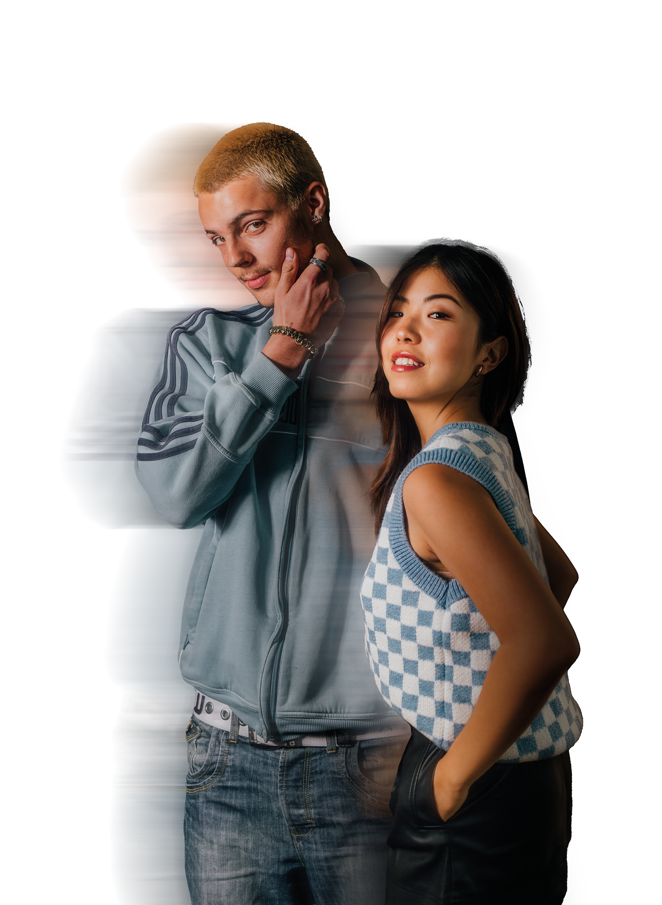
MARKETING FOR FASHION
HOME OF FASHIONS NEXT GENERATION

Slide 2
MARKETING IN FASHION
“If marketing has one goal, it is to meet consumers at the moments that most influence their decisions.”​
​
Court, Elzinga, Mulder & Vetvik, 2009. mckinsey.com​

Slide 3
KNOW YOUR AUDIENCE
Generation Name | Births Start | Births End
Baby Boomers | 1946 | 1964
Generation X | 1965 | 1976
Millennials | 1977 | 1995
Gen Z | 1996 | 2015

Slide 4
ACTIVITY #1
Watch the adverts on the next two slides.
Write what you think is good and bad. Compare the two and the different techniques used to entice you to buy.

Slide 5
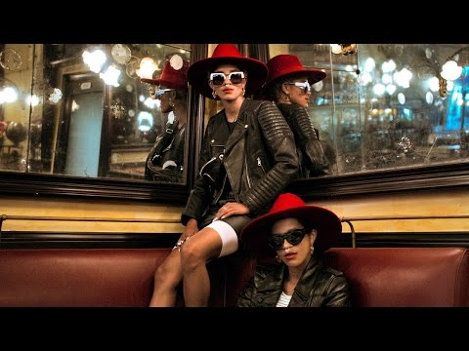

Slide 6
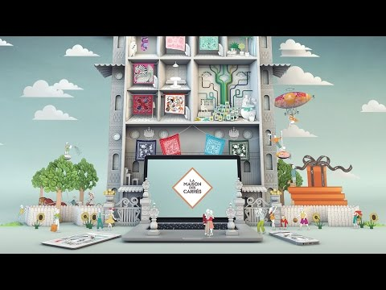

Slide 7
RECAP
Different generations have different needs, wants and spending capabilities​
​Times have changed dramatically and will continue to do so​
​Different generations will interact with different types of marketing channel​
​Being aware of your customers is key to reaching them​
​Digital Marketing is more important than ever and has a key role in the future of marketing​

