Slide 1

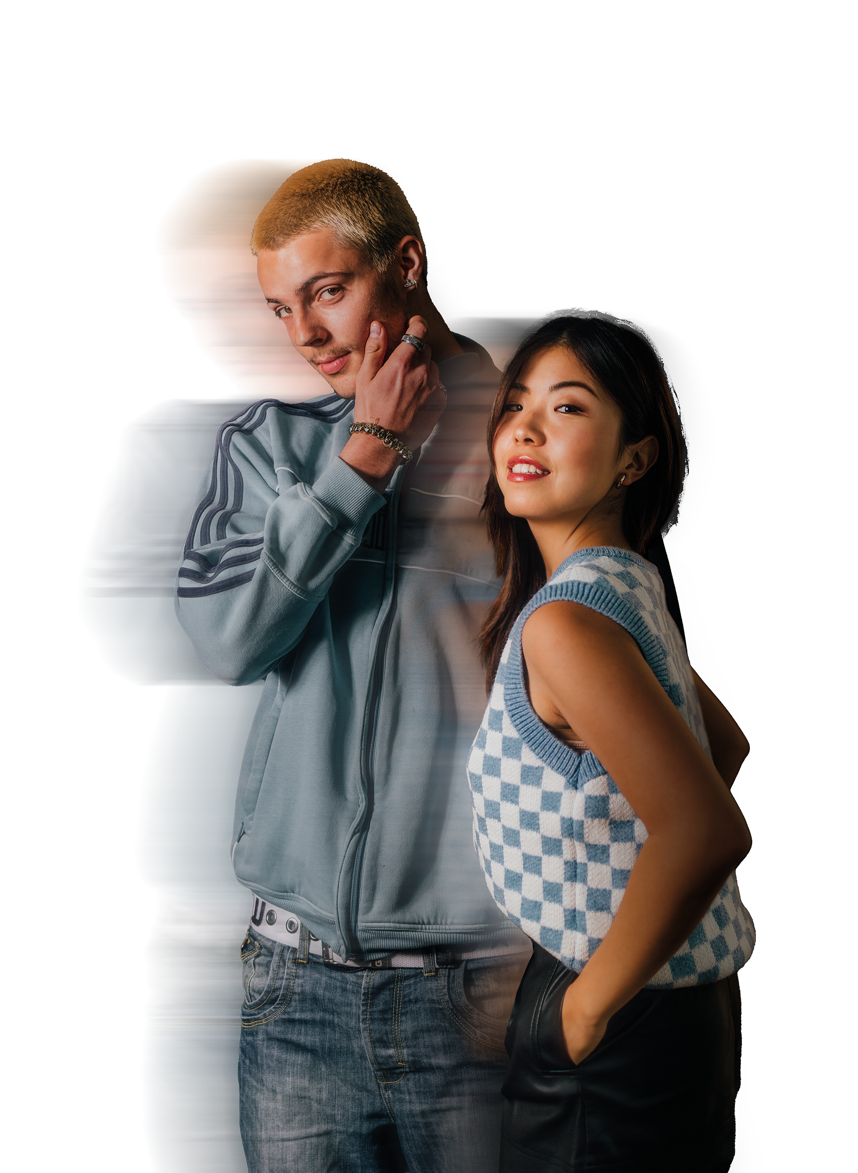
PREPARATION FOR FASHION RETAIL
HOME OF FASHIONS NEXT GENERATION

Slide 2
10 KEY SKILLS
Industry specific skills and knowledge
Numeracy and Literacy for Retail
Research and analysis
Academic writing & referencing
Presentation & communication
Self-reflection and evaluation
Personal Development
Creativity and digital
Teamwork
Planning and time management

Slide 3
CELEBRITY ICON
Throughout time, celebrities such as Audrey Hepburn, Madonna, and David Beckham have changed the way that we dress, with people of all ages, inspired and influenced by celebrity style. While the fashion industry continues to introduce us to new styles every season, the industry would not be where it is today without the help of influential fashion icons.
Your task is to choose a celebrity icon that you think has been influential in fashion – this can be historical or contemporary, to create a digital collage of their style and key looks. Include a short explanation of why your chosen celebrity is influential to fashion.

Slide 4
WHAT IS HERITAGE BRANDING?
“In the traditional sense, a heritage brand is a company that has been around for decades, perhaps centuries, and finds a way to tap into this history in order to obtain loyalty and drive future sales.”
Your task is to conduct research into a heritage brand of your choice to create an article about their history. Here are some examples to choose from – Burberry, Hermes, Louis Vuitton, Chanel, Gucci or Hermes.
You should incorporate images to support your written work, and include a timeline of key events in the brand’s history.

Slide 5
GET READY
Here are some activities you can do to get yourself ready for your career in fashion:
Keep yourself updated on the latest fashion industry and business news - https://www.businessoffashion.com/
Discover the latest fashion trends and industry updates by following Vogue UK or take advantage of their latest annual subscription rates! https://www.vogue.co.uk/
Expand your cultural horizons by visiting museums online or in person, one of our favourites is The Victoria & Albert Museum - https://www.vam.ac.uk/
Watch a fashion documentary! Netflix has a great selection including McQueen and Girlboss as does YouTube.
Search Google Arts & Culture to access to virtual tours and online exhibitions of over 500 museums and galleries worldwide – all for free! https://artsandculture.google.com/search?q=fashion

