Slide 1
PREPARATION FOR FASHION DESIGN
HOME OF FASHIONS NEXT GENERATION

Slide 2
CULTURE CHANGE
Fashion design is influenced by changes in culture and society​
What could be some of the influences on fashion?​
Music​: Spice Girls launched in 1996 inspiring “girl power” and empowering women​
Politics​: Politics went through a huge change in the 1980s, with an economic boom​
Hippy culture: In the 1960s a cultural phenomenon emerged that was inspired by religious spiritualism and fuelled by anti-war sentiment
Can you think of any current culture changes that is affecting fashion?​

Slide 3
HISTORY OF JEANS
Jeans have evolved in the last 70 years from being a form of heavy-duty workwear to a modern fashion staple worn every day by people across the world.​
Invented by Jacob W. Davis and Levi Strauss in 1873​
Initially patented as a garment with copper rivets to protect stress points, with the intention of them being used as workwear *This was the key to making them so popular*​
Popularised in the film Rebel Without a Cause in the 1950s to become a symbol of youth rebellion and culture​
Evolved over the decades since to become more of a fashion item​

Slide 4
ACTIVITY #1
Jeans are a classic example of how culture change has influenced fashion, its design, wearability and acceptability in society. Have a look at the sets of images of jeans on the next slide and think about:​
Which decade each set relates to?​
Why do you think the changes over the years occurred?​
What is the future for jeans?​

Slide 5
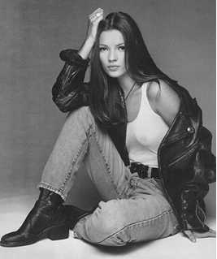
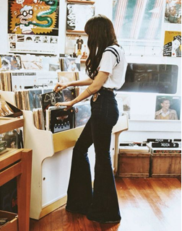
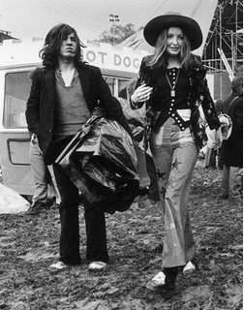
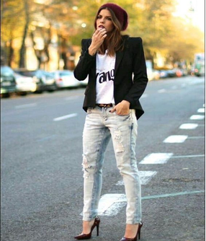
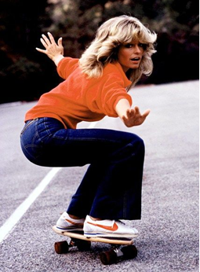
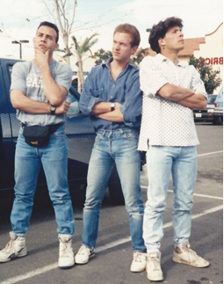

Slide 6
ACTIVITY #2 - INSPIRE
Look at websites WGSN and Pinterest and produce some trend boards based on the information they are predicting.
Trends can be floral, leather, lace, sportswear lux, minimalism, a colour, collars, sleeves, oversized, military, etc. Keep them as reference, think about layout – there is no need to overload the page.

Slide 7
ACTIVITY #3 - DRAW
Draw every day. It does not have to be fashion specific, just develop your line drawing. No need to add colour, this can be life drawing of family members, still life around the house or garden, any view from a window.
If you have magazines at home, start doing some fashion illustrations, draw the figure and think about proportion, 3 heads depth to the waist, elbow to hit waist point and wrist to hit hip point, elongate the legs for illustration purposes
Bring your work together and review and reflect on it, try curating it.

Slide 8
ACTIVITY #4 - WATCH
Netflix and other channels:
Watch McQueen, The Sept issue, DRIES, Jeremy Scott - The People’s Designer, or The Fashion Fund. These will all give you a sense of the design process and how things work.
Does this influence your opinion of the design world?
Does it give you insight to the type of fashion roles you would like?

